Slide 1
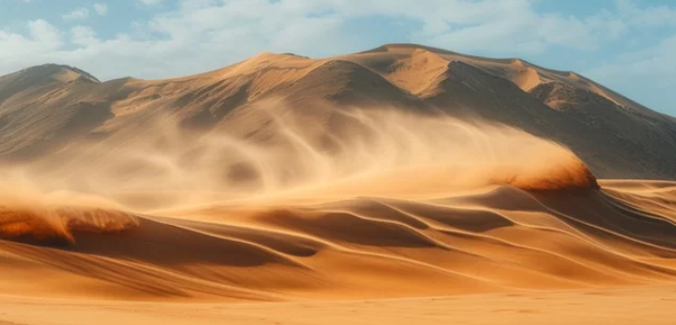
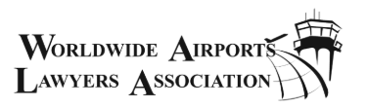
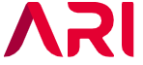
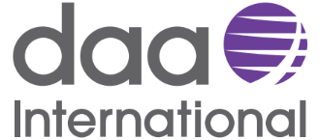
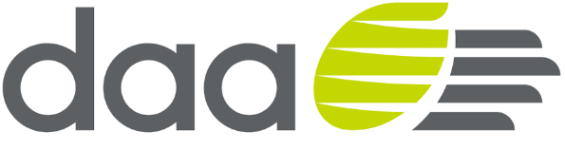
Doing Business in GCC, Saudi Arabia and Bahrain
‘The Winds of Change’
WALA Bahrain Conference 29-31 May 2024

Slide 2
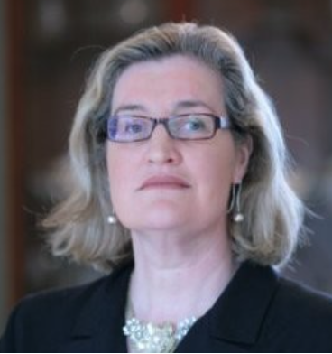

Today’s Panel:
Patricia O’Shea
Group Head of Legal
daa
Khalid A. Alaseeri
Chief Legal Officer
Riyadh airports
Shirin Pishbin
Senior Associate
Trowers & Hamlins, Bahrain

Slide 3

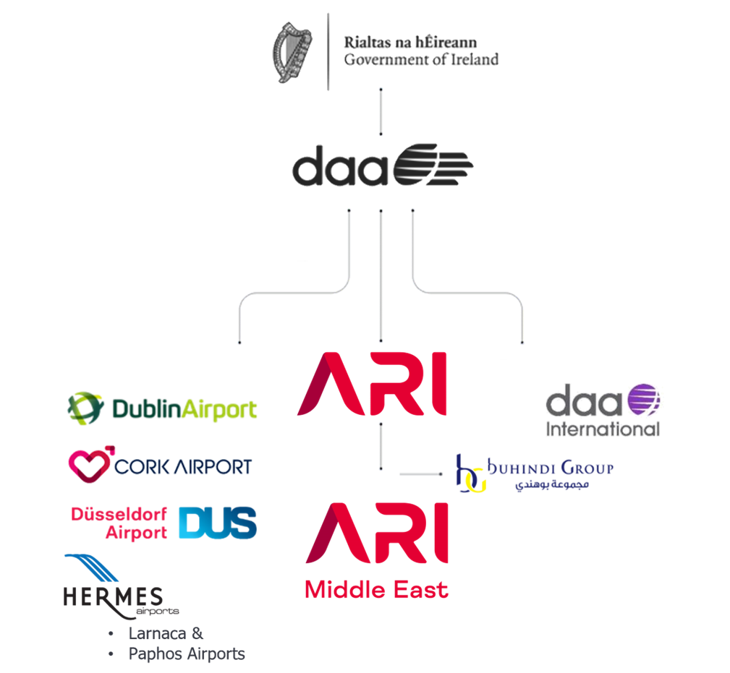
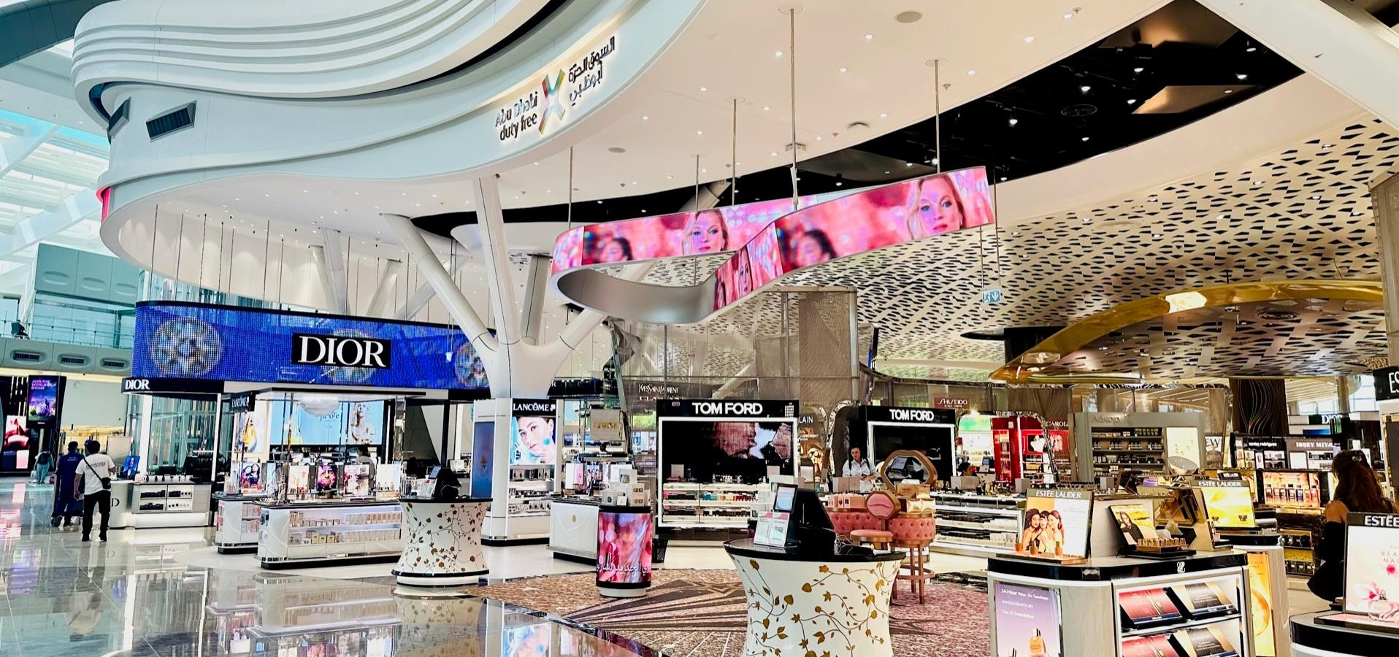
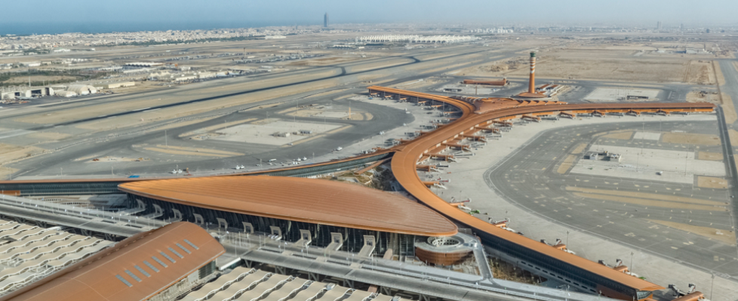
The daa Group
ARI – Abu Dhabi
daa International - Jeddah

Slide 4
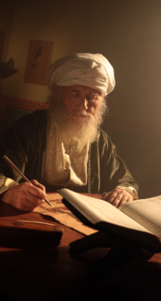
Gulf Cooperation Council (GCC) Country Similarities
Some GCC countries require a national to have ownership in strategic sectors.
Each country has its own specific visa requirements
The obligation for foreign companies doing business to retain a minimum percentage of national employees.
Percentages vary depending on the number of employees and the type of business.
In daa International’s case a Saudi national must hold certain posts – eg: airport security.
ARI & daa International have found this blending to be culturally and operationally positive.
Exemptions to the above can apply if a new or innovative business is being introduced.
Company registration can be complex – enquire and allow adequate time.
Sharia principles on the recovery of loss remain in place - Eg:
  Often not possible to recover future lost profits given that they are uncertain
  Interest provisions for unpaid sums may not be enforceable

Slide 5
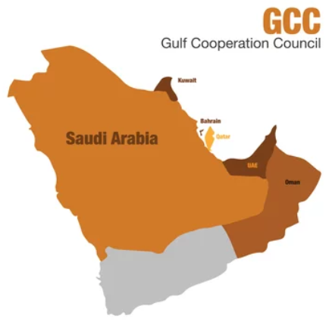
The Legal System in Saudi Arabia
Based on civil law and relies on Shari’ah doctrines and Islamic teachings supplemented by regulations issued by Royal Decree
No reliance on precedent
Currently codifying law previously open to interpretation
The Civil Transactions Law codifies contract and law of torts
Significant alignment between EU standards and KSA over the last decade:
  Competition Law
  Data Protection Law
  Ratification of the Apostille Convention

Slide 6
Airport Corporatisation V State Control
Airports are essential components in any air transport system.
Some routes are in demand and others are more strategic requiring subvention.
The issue is whether to design a profitable airports system or individual commercial airport businesses.
Various solutions have been deployed across the GCC and in KSA specifically.
MANAGEMENT PARTNERSHIP CONTRACT
OPERATE & MAINTAIN
CONCESSION
STATE OWNERSHIP
PUBLIC PRIVATE PARTNERSHIP
DIVESTURE
Full ownership of asset & management. Commission advisory assistance ad hoc
Allows limited autonomy and decision making;
Base fee plus a Profit Share for Partner
SPV for long term concession 10+ Years Control through shareholding
Long-term hand over of use in return for instalments & perhaps a shareholding
Private ownership of infrastructure; state may retain a shareholding
CONCEPT
Maximum State Control
Minimum State Control
Dubai (UAE)
Dublin (Ireland)
Riyadh (KSA)
Jeddah (KSA)
Medina (KSA)
Red Sea (KSA)
Abha (KSA)
Delhi (India)
Heathrow (UK)
EXAMPLES

Slide 7
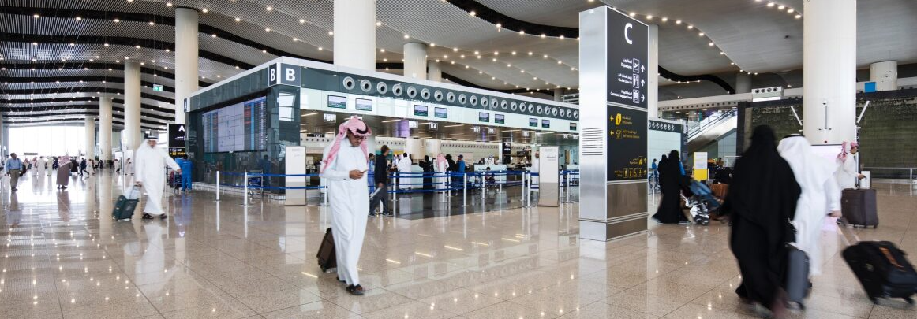
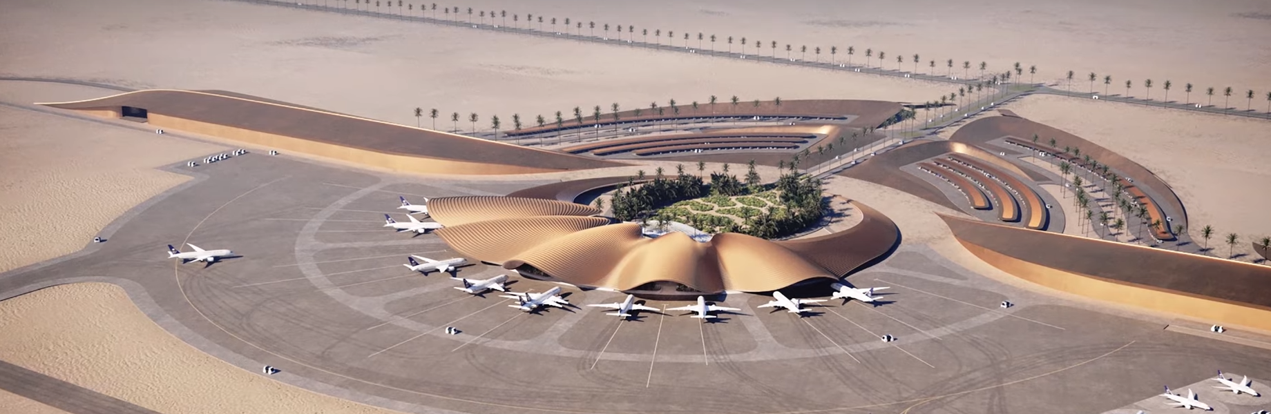
Management Contract V. Operations and Maintenance Concession
Management Partnership Contract
Operations and Maintenance Contract
State retains ownership – participates in control and operation of the airport
The Operator sources and manages all of the subcontractors and concessionaires.
The State contracts with the subcontractors and concessionaires.
The Operator takes a base fee to act as the State’s agent.
The operator’s objective is to deliver knowledge transfer to the State
State retains ownership – light touch control and no operational involvement
The Operator manages the airport and hires in all of the subcontractors – Cleaning, FM, etc. – Often takes passenger forecast risk
The Operator generally lets the concessions and gleans the non-aeronautical revenues – parking, leasing space, etc.
The State gets a payment from the Operator.
Terminal 5, KKIA, Riyadh
Red Sea International Airport, Hanak

Slide 8

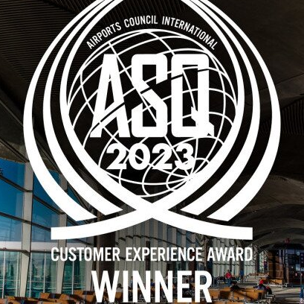
Culture - High Performance Expectations
Continuous high performance and close attention to the business and personal relationship are essential to achieving success and longevity.
Companies need to be cognisant of , but flexible with, their contractual obligations – going the extra mile creates good will..
It is important to reintroduce any new C-Suite executives to the contract and its deliverables as soon as possible in order to ring fence responsibilities and expectations.
Encourage the use of mediation and rectification plans
Litigation provides little room for an amicable resolution and can be reputationally damaging

Slide 9
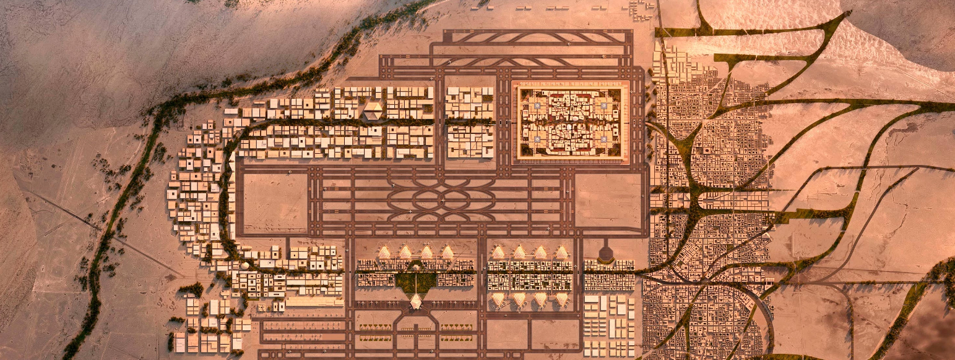
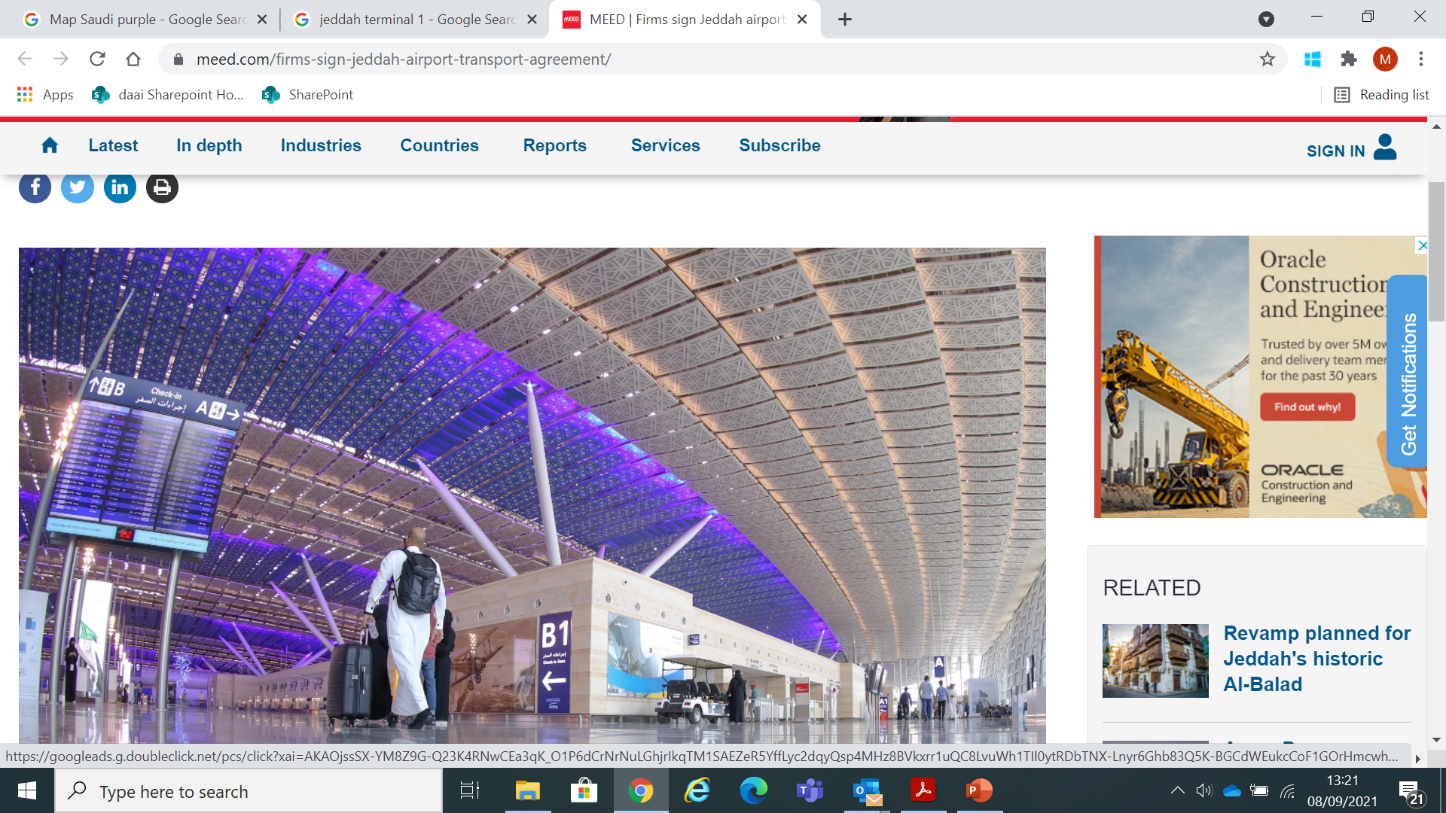
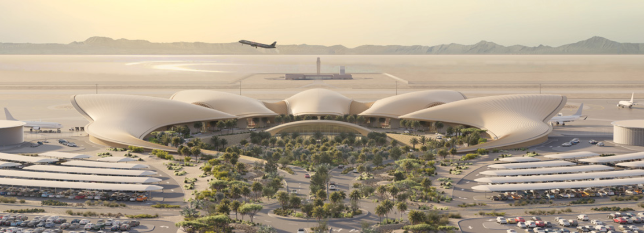
Airport Specific Observations
King Salman International Airport, Riyadh
Significant change in the GCC airports underway
New ‘supersized’ airports underway plus a focus on upgrading the smaller regional facilities
Most GCC countries have a single State agency responsible for all aspects of civil aviation
The trend is toward splitting these agencies into distinct stand-alone divisions within the sector
KSA is leading the way in this initiative – GACA, SANS, SAVIT, MATARAT
daa International has been a key contributor to developing and delivering these strategies in the airports space
King Abdulaziz International Airport, Jeddah
Red Sea International Airport, Hanak

Slide 10
The Legal System in Bahrain
Civil code of 2002 regulates civil transactions including business negligence lawsuits and practice, and more specific legislation has been introduced such as the Commercial Companies Law, Labour Law, Data Protection Law etc.
Civil Law Courts deal with all cases relating to civil, commercial and criminal law. Shariah courts only deal with the personal status of Muslims.
Bahrain Chamber of Disputes Resolution (BCDR) provides arbitration and mediation services for commercial disputes)

Slide 11
Some Observations
Bahrain encourages investment into the region
Bahrain has a high ranking across a number of global indices, including ease of doing business
Low operating costs in the MENA region (commercial rents, skilled labour, utilities)
End to end eGovernment portal (Bahrain.bh) with most government services in one platform Number of free trade zones established.

Slide 12
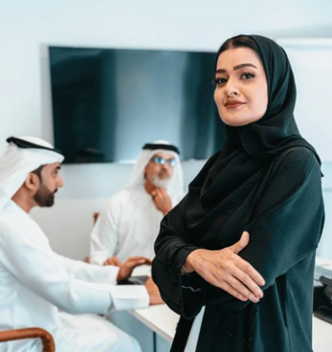
The GCC Legal Environment is Changing
Very high calibre regional legal talent is becoming the norm.
Gender balance is changing – particularly prevalent in law.
Often linked to the increase in spending on national infrastructure and PPP models.
A strong, trusted team of local advisors in legal, tax and finance is highly recommended to ensure success.

Slide 13

Trowers & Hamlins
Trowers is an international law firm with over 170 partners and more than 1000 people located across the UK, Middle East and Asia.
Active in Bahrain since 1959, we are market leaders, combining local understanding and deep relationships with international expertise and strategic thinking.
We have deep roots in the country and strong relationships with key decision-makers and stakeholders in Bahrain's economy.
We are involved in advising on the core of Bahrain's critical infrastructure, from its airport to its bus network to its power plants. We have advised on the majority of the island's major development projects and the first ever housing PPP.

Slide 14




Trowers and Bahrain International Airport
Trowers advised on the drafting and negotiation of the concession agreements at the new airport
Negotiated with local franchisors such as Alshaya (Starbucks, Boots), That al Salasil (WH Smith), Fakhro (McDonalds), Jashanmal (Relay), and SSP. As well as local banks, forex, telecommunications companies and F&B.
Key features of the Concession Agreements: revenue share, KPIs, performance bond, minimum fit-out obligations, security/airport regs

Slide 15
Local law considerations for Concession Agreements
Tender law
  All concessionaires were awarded their agreements based on tenders
  Tender process governed by Bahrain Tender Law
Local presence – concessionaires must have a local presence which will be subject to the local company laws
Compliance with local laws e.g. Bahrainisation and Labour Law, trade licence and permits
Lease vs Licence
  Registration/landlord and tenant law
  Deposit vs Performance Bond
  Dispute Resolution – Arbitration vs Local Courts

Slide 16

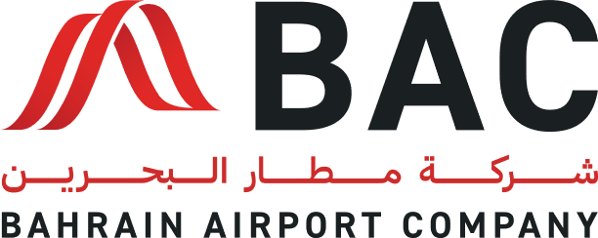
Doing Business in the GCC
Name: Khalid A. Alaseeri
Organization: Riyadh Airports Company
Date: 5/30/2024
HOSTED BY:

Slide 17
Comparison of Old and New Companies Laws in Saudi Arabia
Old Companies Law (1965 updated 2015 ):
-Establishment: The process was more bureaucratic and time-consuming.
- Capital Requirements: Higher minimum capital requirements for certain types of companies
- Corporate Governance: Less emphasis on corporate governance standards.
- Foreign Ownership: Restrictions on foreign ownership in many sectors.
- Regulatory Environment: Outdated regulations that did not accommodate modern business practices.
New Companies Law (2022):
- Establishment: Simplified procedures for company registration and establishment.
-Capital Requirements: Lowered or eliminated minimum capital requirements for various business types.
-Corporate Governance: Enhanced focus on corporate governance, transparency, and accountability.
-Foreign Ownership: Increased openness to foreign investment with fewer restrictions.
-Regulatory Environment: Modernized laws to support contemporary business practices and encourage entrepreneurship.

Slide 18
New Civil Transactions Law and Recent Legal Changes
New Civil Transactions Law (2023):
- Objective: To regulate civil transactions and contracts, providing a clear legal framework.
- Key Features:
- Codification of civil law principles, making it easier to understand and apply.
- Protection of contractual rights and obligations.
- Introduction of provisions to handle electronic transactions and digital contracts.
Recent Legal Changes:
- Bankruptcy Law (2018): Introduced to provide a framework for resolving insolvency issues, aiming to support failing businesses and protect creditors.
- Commercial Courts Law (2020): Established specialized courts for handling commercial disputes efficiently.
- Privatization Law (2021): Encouraged private sector participation in state-owned enterprises to boost economic diversification.
- Anti-Concealment Law (2020): Aimed at combating commercial concealment practices and ensuring fair market competition.

Slide 19
Impact and Future Outlook
Impact of New Laws:
- Business Environment: The reforms have made Saudi Arabia more attractive for both local and foreign investors.
-Economic Diversification: The legal changes support Vision 2030 goals, focusing on economic diversification and reducing reliance on oil.
-Ease of Doing Business: Simplified regulatory processes and modernized legal frameworks have improved the ease of doing business in Saudi Arabia.
Future Outlook:
-Continued Reforms: The Saudi government is expected to continue its legal and economic reforms to foster a competitive business environment.
-Digital Transformation: Ongoing emphasis on digitization and innovation in legal frameworks to keep pace with global trends.

Slide 20
Economic Policies Regulations for Aviation in Saudi Arabia
Old Aviation
Tariff Regulations:
Economic Policies
Regulations for Aviation:
Key Features of the Economic
Policies Regulations for Aviation:
- Structure: Based on outdated economic policies and less adaptable to modern aviation needs.
- Tariff Rates: Fixed rates with limited flexibility for adjustment according to market demands.
- Regulatory Oversight: Less stringent oversight and fewer compliance requirements.
- Service Quality: Inconsistent service quality across different airlines and airports due to lack of standardized regulations.
- Modernized Framework: Updated to align with international standards and best practices.
- Dynamic Tariff Rates: Flexibility to adjust tariffs based on market conditions and economic factors.
-Enhanced Regulatory Oversight: Stricter compliance requirements to ensure safety, security, and service quality.
- Service Quality Improvement: Implementation of standardized regulations to ensure high-quality services across all airlines and airports.
-Economic Impact: Designed to attract more investments into the aviation sector and support the growth of the Saudi aviation market.
- Economic Policies: Policies aimed at integrating private investment and promoting competition within the aviation sector.
- Tariff Adjustments: Mechanisms for periodic review and adjustment of tariffs to reflect economic realities and market dynamics.
- Consumer Protection: Enhanced measures to protect consumer rights and ensure fair pricing.
- Investment Attraction: Regulations that encourage both domestic and international investments, contributing to the development of the aviation infrastructure.

Slide 21
Economic Policies Regulations for Aviation in Saudi Arabia
Old Aviation
Tariff Regulations:
Economic Policies
Regulations for Aviation:
Key Features of the Economic
Policies Regulations for Aviation:
- Structure: Based on outdated economic policies and less adaptable to modern aviation needs.
- Tariff Rates: Fixed rates with limited flexibility for adjustment according to market demands.
- Regulatory Oversight: Less stringent oversight and fewer compliance requirements.
- Service Quality: Inconsistent service quality across different airlines and airports due to lack of standardized regulations.
- Modernized Framework: Updated to align with international standards and best practices.
- Dynamic Tariff Rates: Flexibility to adjust tariffs based on market conditions and economic factors.
-Enhanced Regulatory Oversight: Stricter compliance requirements to ensure safety, security, and service quality.
- Service Quality Improvement: Implementation of standardized regulations to ensure high-quality services across all airlines and airports.
-Economic Impact: Designed to attract more investments into the aviation sector and support the growth of the Saudi aviation market.
- Economic Policies: Policies aimed at integrating private investment and promoting competition within the aviation sector.
- Tariff Adjustments: Mechanisms for periodic review and adjustment of tariffs to reflect economic realities and market dynamics.
- Consumer Protection: Enhanced measures to protect consumer rights and ensure fair pricing.
- Investment Attraction: Regulations that encourage both domestic and international investments, contributing to the development of the aviation infrastructure.

Slide 22
Discussion
Q&A

