Slide 1
A Brief Introduction to
Urban Air Mobility
Dr Benjamyn I. Scott
International Institute of Air and Space Law, Leiden University
28 May 2025

Slide 2
Innovative Aerial Services (IAS)
NPA 2022-06
Innovative Aerial Services (IAS) NPA 2022-06
Operations and services that benefit citizens and the aviation market, enabled by new airborne technologies:
Electrical Vertical Take-Off and Landing (eVTOL) Aircraft
Unmanned Aircraft Systems (UAS)
Other Aircraft
Innovative Air Mobility (IAM)
Aerial Operations
Innovative Air Mobility (IAM)
Surveillance
Mapping
Telecommunications
Urban Air Mobility (UAM)
To, within or out of an urban environment
Urban Air Mobility (UAM)
To, within or out of an urban environment
Operations and services that benefit citizens and the aviation market, enabled by new airborne technologies:
Electrical Vertical Take-Off and Landing (eVTOL) Aircraft
Unmanned Aircraft Systems (UAS)
Other Aircraft
Aerial Operations
Surveillance
Mapping
Telecommunications
Regional
International
Regional
International

Slide 3
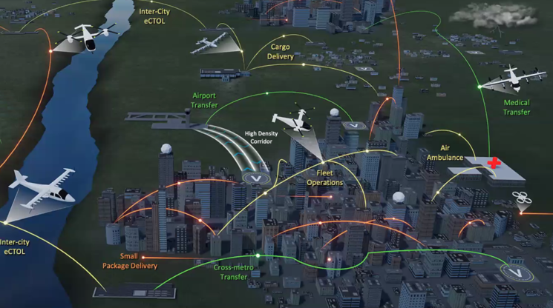
Urban
It could be understood to include different types of airborne operations: Intra-City: An operation within a single city. Peri-City: An operation between a city and a location outside the city. Inter-City: An operation between more than one urban area. Urban-Rural: An operation between 2 points crossing urban areas.

Slide 4
People Centric

Slide 5
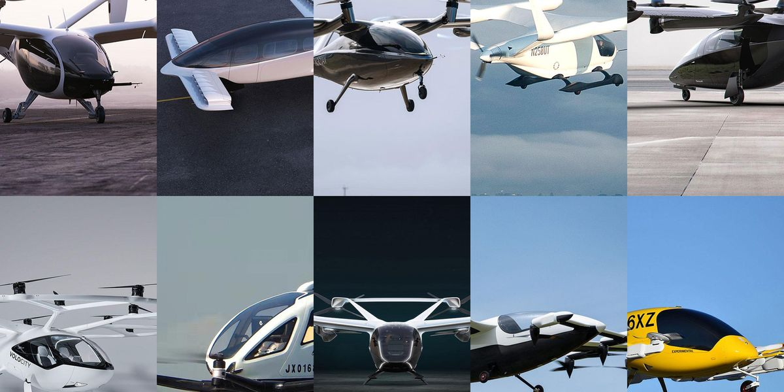
Air
Often, a focus on the aircraft. It is not confined to this. For example, these aircraft will require: ATM/UTM services. Ground infrastructure (incl. vertiports). Manufacturers and maintenance. Interoperable interfaces with other transport stakeholders – Urban Mobility.

Slide 6
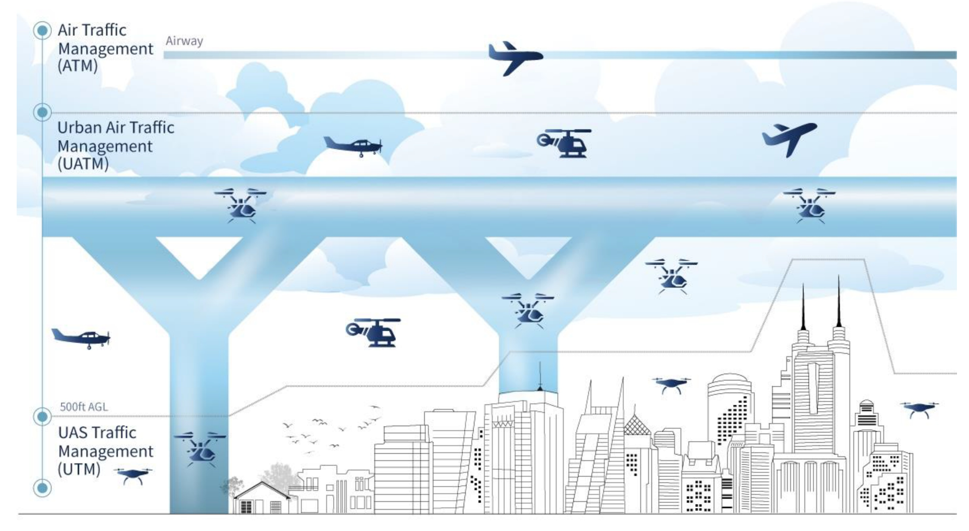
Utilising the Third Dimension

Slide 7
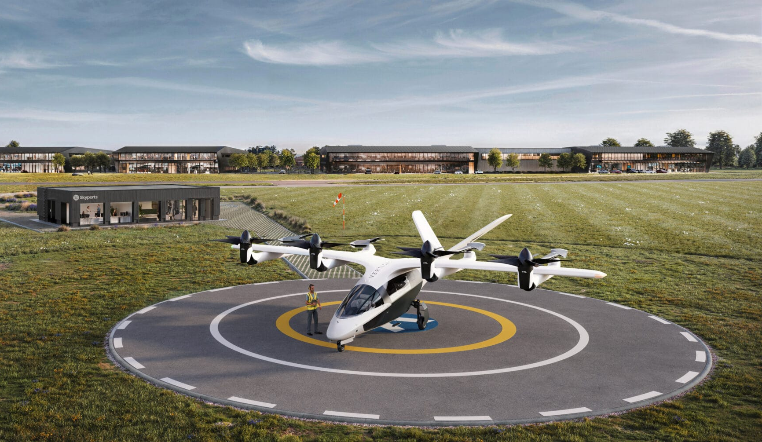
Mobility
Includes the movement of people and cargo. It is not just by air and is inherently linked to other mobility services, such as: E-scooters Trams, Buses, Trains Cars, Trucks and Vans Other Aircraft

Slide 8
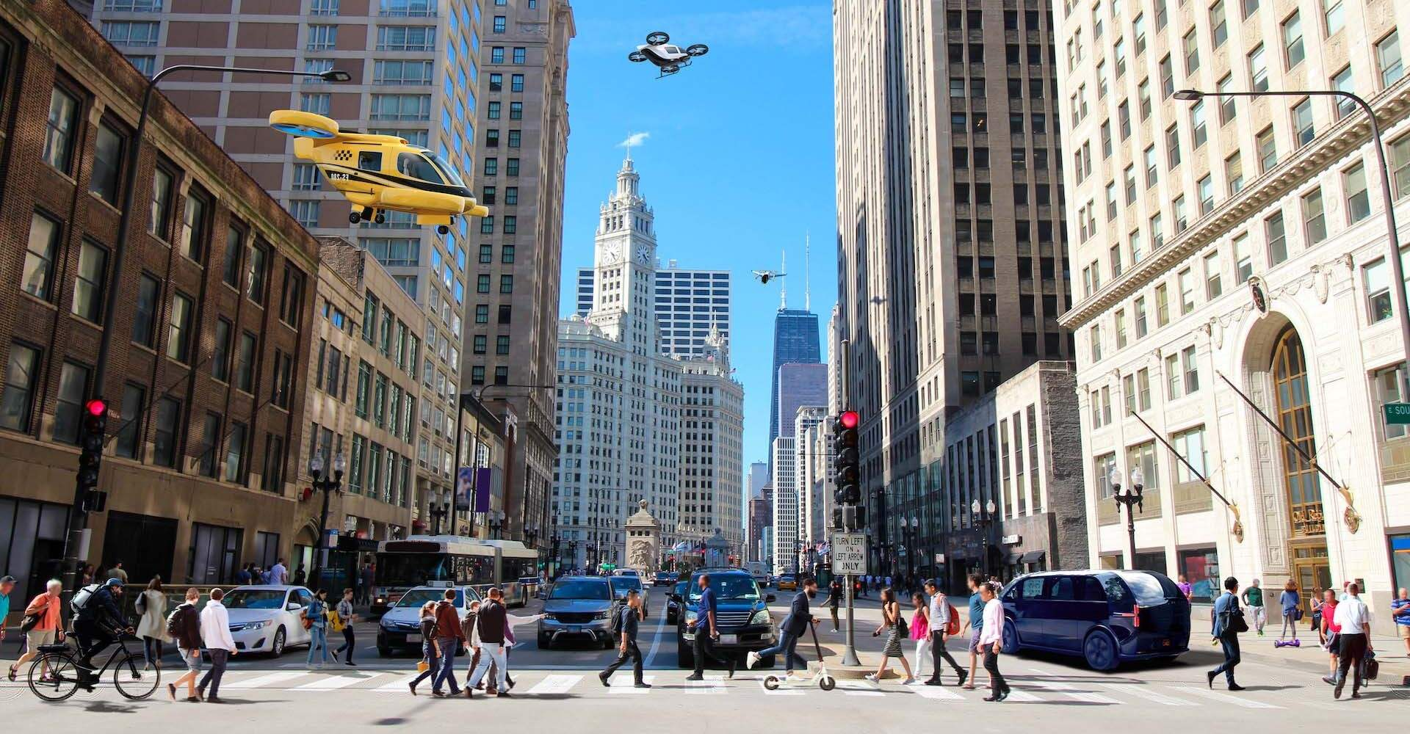
Moving you from where you are to where you want to be

Slide 9
Why Urban Air Mobility?
Potential to ease congestion through synergies with other modes of transport, improve response times for time-critical operations, reduce pollution and improve quality of daily life in cities and regions.
Passenger Transport
Cargo Delivery
Farming
IT Infrastructure
Medical
Policing
Tourist Flights
Other …

Slide 10
Risks and Opportunities (1)
Safety
Airworthiness: certification, initial & cont., maintenance.
Operations: rules of the air, ASA, AOL.
License: pilots, observers, operators, crew.
Infrastructure: airports v. vertiports.
Traffic man.: ATM, UTM.
Security
Ground: airside, landside.
Airborne: unruly passengers, third parties.
Cyber: ground and airborne.
Non-avionic: phone app.
Environment
Emissions: CO², NOX.
Other: noise, light, visual.
Wildlife: urban, rural, migratory.
Life cycle: batteries, composite materials.
Rights of People
Data protection: PNR, banking details.
Nuisance: overflight, ground facilities.
Freedom of movement: move within and between 1 country.
Consumer protection: liability, delays, cancellation, denied boarding.

Slide 11
Risks and Opportunities (2)
Access
Affordable: democracy of services v. profitability.
Connectivity: other modes of transport.
Origins: market pull v. market push.
Use case: early movers.
Hype
Technology: now, close, far off, sci-fi.
Services: necessary, convenient, luxury.
Cost: affordable, sustainable, profitable.
Time frame: short-term, mid-term, long-term.
Novelty
Replace existing services: taxis, delivery vans, manned aviation.
Create new services: medical services to remote locations, high speed last mile delivery.
Jobs
New jobs: (remote) pilots, ground crew, manufacturing, secondary.
Replace old jobs: delivery and taxi drivers, manned aviation.
Support existing jobs: linked to existing transport modes, sectors.
Temporary jobs: evolution due to tech advancements and business needs.

Slide 12
THANK YOU!
Dr Benjamyn I. Scott
International Institute of Air and Space Law, Leiden University
Assistant Professor
b.i.scott@law.leidenuniv.nl

